Slide 1
APPLIED ANALYTICS · BUSINESS INTELLIGENCE
Business Diagnostics
Meets Applied Analytics
Turning Operational Data into Strategic Intelligence
A case study on multidimensional organizational maturity analysis
using Python · Power BI · K-Means Clustering · Gap Analysis
Brazilian Licensed Accountant (CRC/CFC) · Master's Student in Big Data Analytics · May 2026

Slide 2
PROJECT
CONTEXT
DATA SOURCES & STRUCTURE
①
Structured Interviews
Scored 0–100% per business dimension, 9 core analytical variables
This anonymized case study shows how business diagnostics can be translated into structured analytical intelligence.
②
Document Analysis
Financial records, cost distribution, fixed costs, liquidity indicators
An organizational maturity framework was applied across 5 business dimensions, transforming field data into actionable insights.
③
Direct Observation
Operational workflows mapped and encoded for analytical compatibility
Developed as an Applied Analytics / BI project aligned with Big Data Analytics studies.
④
Synthetic Dataset
Created for reproducibility — no real client data, no CNPJs, no names

Slide 3
TECHNICAL EXECUTION
Tools · Processing · Analysis Pipeline
Python
sklearn
Power BI
matplotlib
Pandas · NumPy
KMeans · Metrics
BI Dashboards
EDA Visualization
Data Ingestion
Cleaning & Normalization
Descriptive Stats & Gap Analysis
01
02
03
Raw maturity scores and financial records loaded from CSV
Min-max scaling applied per feature; categorical indicators encoded
Mean, std, percentile per dimension; gap to full maturity computed
K-Means Clustering
BI Dashboard Output
04
05
Elbow Method + silhouette score (0.61) → optimal k=3 selected
Scalable schema structured for Power BI integration

Slide 4
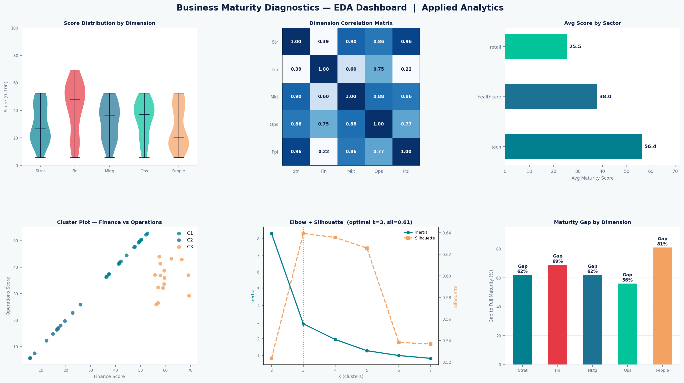
EDA DASHBOARD
Score Distribution · Correlation · Clustering · Gap Analysis
Python · matplotlib · sklearn | Synthetic dataset — no real client data

Slide 5
MATURITY RADAR — 5 BUSINESS DIMENSIONS
Current scores vs. full maturity
Strategy
38%
Score: 38% · Gap: 62 pts
Finance
31%
Score: 31% · Gap: 69 pts
Marketing
38%
Score: 38% · Gap: 62 pts
Operations
44%
Score: 44% · Gap: 56 pts
People Mgmt
19%
Score: 19% · Gap: 81 pts
* Scores represent current maturity level (0–100%). Gap = points to full maturity.

Slide 6
K-MEANS CLUSTERING — MATURITY PROFILES IDENTIFIED
K-Means clustering (k=3) was applied to the normalized maturity score matrix as an exploratory segmentation technique — suitable for pattern discovery on this dataset scale, and not intended as a production-grade model. Optimal k was determined using the Elbow Method (inertia inflection at k=3) and validated with a silhouette score of 0.61, confirming well-separated clusters.
Cluster C1
Cluster C2
Cluster C3
Finance ↑ Strategy ↓
All areas ~40–50%
All areas < 30%
High Finance / Low Strategy
Balanced Moderate
Low Maturity — Critical
Strong cost control, weak strategic direction. Needs planning frameworks and OKR implementation.
Consistent mid-range performance across all dimensions. Ready for optimization and BI layer.
Critical gaps across all dimensions. Highest priority for immediate intervention and structuring.
* Clustering applied to anonymized score matrix. Profiles reflect anonymized patterns observed during the diagnostic process.

Slide 7
ESTIMATED IMPACT — DATA-DRIVEN INTERVENTIONS
Based on internal diagnostic patterns and conservative scenario assumptions:
12–18%
~25%
↓ Risk
Estimated cost reduction potential
Potential improvement in strategic alignment
Potential liquidity risk exposure
conservative scenario — fixed-cost rationalization & workforce opt.
modeled estimate — OKR framework and short-term planning
estimated — future cash-flow forecasting models (proposed)
* Modeled estimates, not guaranteed outcomes. Based on diagnostic patterns and conservative scenario modeling.

Slide 8
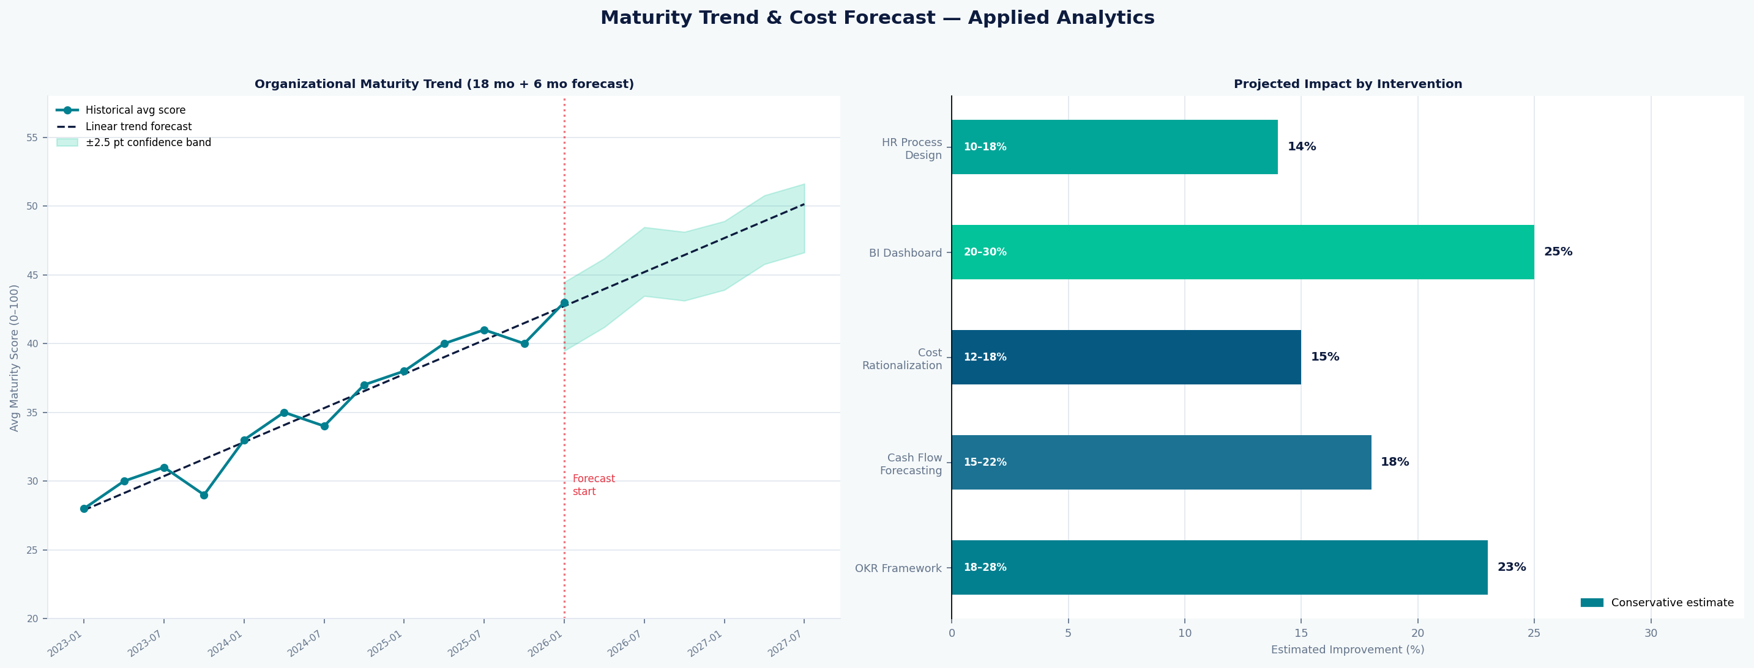
TREND FORECAST & IMPACT DASHBOARD
18 mo historical · 6 mo forecast · Intervention impact
Python · matplotlib | Linear regression trend + ±2.5 pt confidence band | Conservative scenario modeled estimates

Slide 9
CRITICAL FINDINGS — THE 5 WORST INDICATORS
25%
Short-term strategic planning
Absence of OKRs — roadmapping framework recommended.
50%
Accounting control & asset separation
Personal/business finances mixed — critical compliance risk.
25%
Financial KPIs (profitability & ROI)
Basic KPIs nonexistent — entry point for financial BI.
50%
Working capital management
No cash flow projection — liquidity risk exposure.
~30%
Segment-focused marketing planning
Undifferentiated communication — ML clustering opportunity.

Slide 10
HIGHLIGHTS — THE 5 BEST INDICATORS
100%
Customer satisfaction & loyalty
Foundation for NPS tracking and churn analysis.
100%
Real alignment with customer needs
Product-market fit confirmed — scalable with demand forecasting.
100%
Operational loss control (logistics)
Excellent efficiency — ready for real-time dashboard monitoring.
100%
Innovation & product update culture
Agile mindset present — compatible with continuous improvement.
100%
Word-of-mouth & offline media marketing
High social capital — amplifiable with data-driven digital marketing.

Slide 11
ANONYMIZED FINANCIAL ANALYSIS — DATA PIPELINE
Payroll
Distributed across operational, administrative, and management roles, with variable daily allowances per attendance — automatable with workforce optimization models.
Fixed Costs
Significant concentration in rent, utilities, and health benefits — a predictable and time-series-modelable cost base (ARIMA/Prophet applicable).
Pro-labore & Consulting Fees
Identified as a high-impact EBITDA variable — sensitivity analysis recommended via Monte Carlo simulation.
Total Mapped Cost
A significant monthly cost base across multiple units, with a notable share concentrated in the primary unit — a key indicator for expansion or rationalization decisions.
All financial data has been fully anonymized. No real values, CNPJs, or client names are present.

Slide 12
ANALYTICS APPLICATIONS — APPLIED & PROPOSED
K-Means
Applied
ARIMA / Prophet
Proposed
Monte Carlo
Proposed
Maturity Clustering
Time Series Forecasting
Sensitivity Analysis
Group companies by deficiency profile for benchmarking. Silhouette 0.61, k=3.
Project fixed costs and cash flow from historical data — time-series-ready cost base identified.
Simulate variable cost fluctuations on net income — pro-labore identified as high-impact variable.
Power BI + Python
Applied
BERT / LLM
Proposed
Predictive Dashboards
NLP on Qualitative Feedback
Integrated KPI panel — financial, operational, marketing metrics unified.
Extract sentiment and patterns from structured interview responses.

Slide 13
CONCLUSION
Maturity Level 3 — Intermediate
The multidimensional diagnostic revealed that processes exist, but operate in a fragmented way.
The greatest opportunity lies in the data layer — the organization generates valuable information daily,
yet lacks the analytical structure to turn it into decisions.
This case demonstrates that the real value of analytics is not in the tools, but in the ability to frame the right business problem, structure the data, and translate findings into actionable strategy.
Open to internship, CPT, and entry-level opportunities in Data Analytics, Business Intelligence & Financial Data Analysis.
Brazilian Licensed Accountant (CRC/CFC) · Master's Student in Big Data Analytics · May 2026

